Slide 1
Social Determinants of Health & CRANE: What measures for research?
Jim Campbell
Carol R Geary
Jerrod Anzalone
Jim Svoboda
University of Nebraska Medical Center
Omaha, NE, USA

Slide 2
Objectives
Discover what is a Social Determinant of Health(SDH) fact?
Inventory Nebraska EHR and public domain datasets for available SDH facts that might support research
Organize and standardize SDH datasets for clinical research into interoperable SDH facts database compliant with CDM v6

Slide 3
What we did:
Reviewed publications from HP 2030 and WHO; extracted assessments framework
Consulted research sociologists at Texas A&M and UT San Antonio
Inventoried public datasets with useful geocoded content
Reviewed USCDI plans for SDH
Inventoried our Epic flowsheets and patient-level demographics
Consulted with HL7/GRAVITY and OHDSI/Health Equities terminology committees
Developed reference tables and utilities for public datasets and deployed ETLs for UNMC

Slide 4
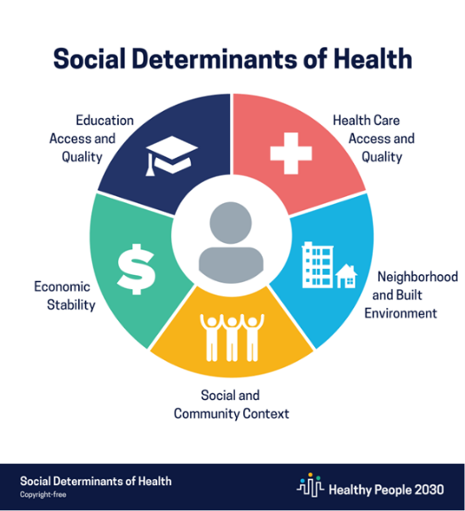
HP 2030 Framework

Slide 5
SDOH Domains (HP2030)
Economic Stability
Education Access and Quality
Healthcare Access and Quality
Community, Neighborhood and Built Environment
Social and Community Context
Datapoints regarding
Observations on Personal Socioeconomic Roles and Characteristics from EHR or PRO
Community Infrastructure, Environment, Socioeconomics and Societal Attitudes (that can be referenced to patient’s neighborhood

Slide 6
Social Determinants of Health: Observable Datasets
“Social determinants of health (SDOH) are the conditions in the environments where people are born, live, learn, work, play, worship, and age that affect a wide range of health, functioning, and quality-of-life outcomes and risks”
Healthy People 2030; USHHS-Office of Disease Prevention and Health Promotion
“The social determinants of health (SDH) are the non-medical factors that influence health outcomes. They are the conditions in which people are born, grow, work, live, and age, and the wider set of forces and systems shaping the conditions of daily life. These forces and systems include economic policies and systems, development agendas, social norms, social policies and political systems.”
https://WHO.int/health-topics/social-determinants-of-health
Equities community primarily focuses on racial, ethnic, cultural and
socioeconomic status variables

Slide 7
USCDI SDH Terminology Standards
Datatype | ONC Standards and Valuesets
Goals | SNOMED CT, LOINC
Problems | SNOMED CT, ICD-10-CM
Assessments | SNOMED CT, LOINC
Interventions | SNOMED CT, CPT-4, HCPCS
Demographics | OMB Standards, CDC Race and Ethnicity codes, HL7 code sets, SNOMED CT, LOINC

Slide 8
Pragmatic Data Review: Epic Patient-level data
Examine the semantics of structured data found in Nebraska Medicine EHR, looking for data elements relevant to the HP2030 domains
We found most information in Clarity PATIENT, SOCIAL_HX and throughout flowsheets data
Extract the data elements and associated datasets to a SDH metadata library
Code with LOINC or SNOMED CT as available to standardize for interoperation per ONC; MANY concepts had no LOINC code published

Slide 9
Public Datasets Review
Our Sociologists first directed us to;
American Community Survey (Census)
Wisconsin Area Deprivation Index(ACS)
We then reviewed and found useful data in:
Rural-Urban Commuting Area Code(DoA)
Food Environment Atlas (USDA ERS)
Social Vulnerability Index (Homeland Security, Census)
Bird Index (ACS)
[Air Quality Index(EPA)]
Jim Svoboda extracted the relevant reference tables to our github site and developed python to compute composite indices

Slide 10
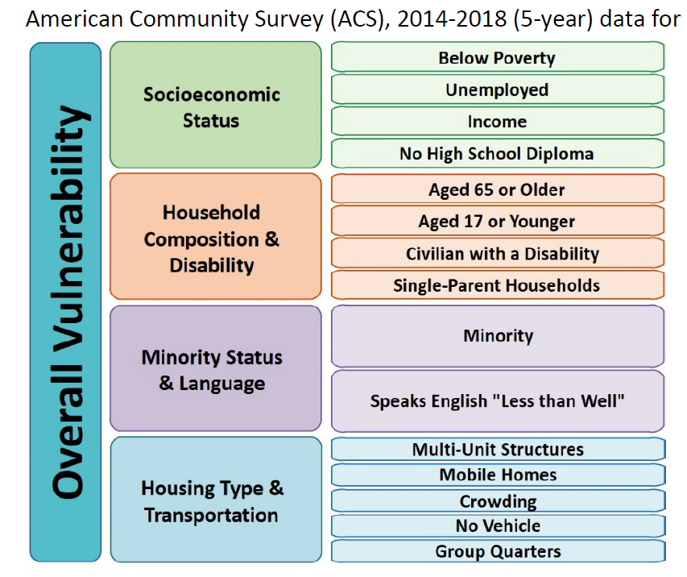
Social Vulnerability Index

Slide 11
Deployment in CDMV6
NEBRASKA_SEMANTIC_CODE_FREQUENCY.xlsx
Code counts across all CDM datasets at UNMC
SDH_Data_Inventory: final inventory of SDH data we plan to deploy
SOC_DET_OF_HEALTH: what we have deployed today into OBS_GEN and OBS_COMMUNITY
Reference tables and python code in github repository UNMC-CRANE https://github.com/UNMC-CRANE/SDH

